Slide 1
Applications of the Dot Product and the Cross Product

Slide 2

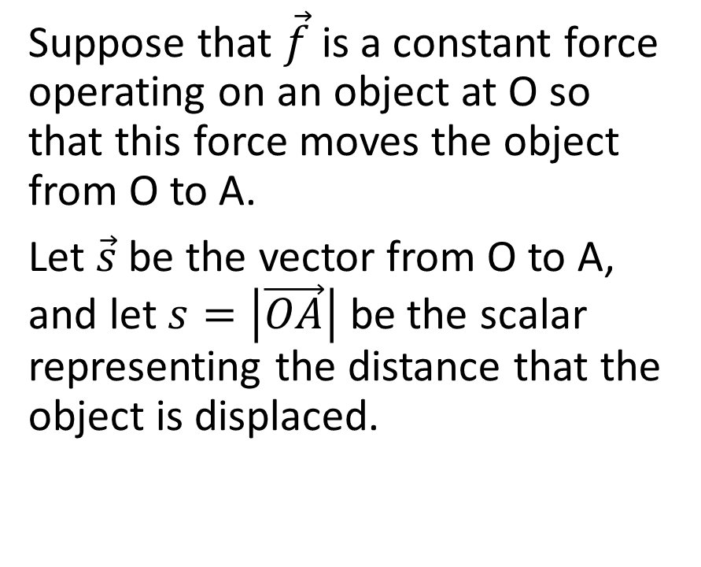

Application 1: Work
Suppose that $\vec{f}$ is a constant force operating on an object at O so that this force moves the object from O to A.
Let $\vec{s}$ be the vector from O to A, and let $s=\left|\vec{OA}\right|$ be the scalar representing the distance that the object is displaced.
B
$$\vec{f}$$
O
N
A

Slide 3
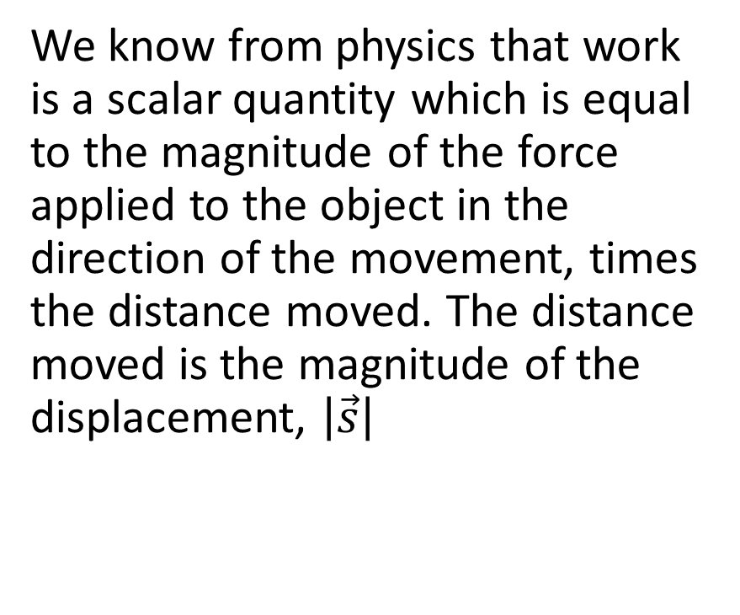
We know from physics that work is a scalar quantity which is equal to the magnitude of the force applied to the object in the direction of the movement, times the distance moved. The distance moved is the magnitude of the displacement, $\left|\vec{s}\right|$
B
$$\vec{f}$$
O
N
A

Slide 4
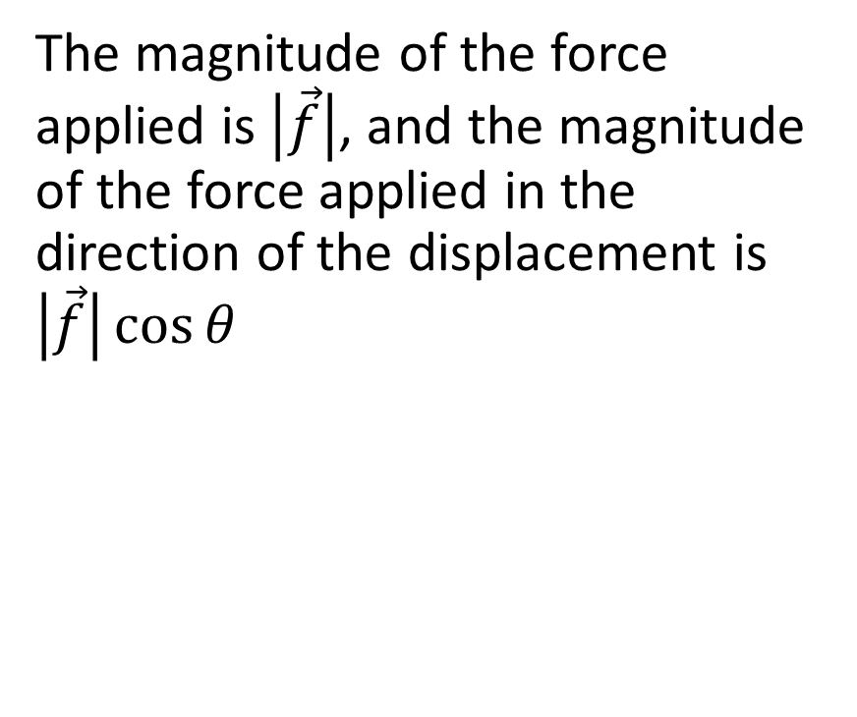
The magnitude of the force applied is $\left|\vec{f}\right|$, and the magnitude of the force applied in the direction of the displacement is $\left|\vec{f}\right|\cos{θ}$
B
$$\vec{f}$$
O
N
A

Slide 5
Work = (force in the direction of movement) x (distance traveled)
B
$$\vec{f}$$
O
N
A

Slide 6
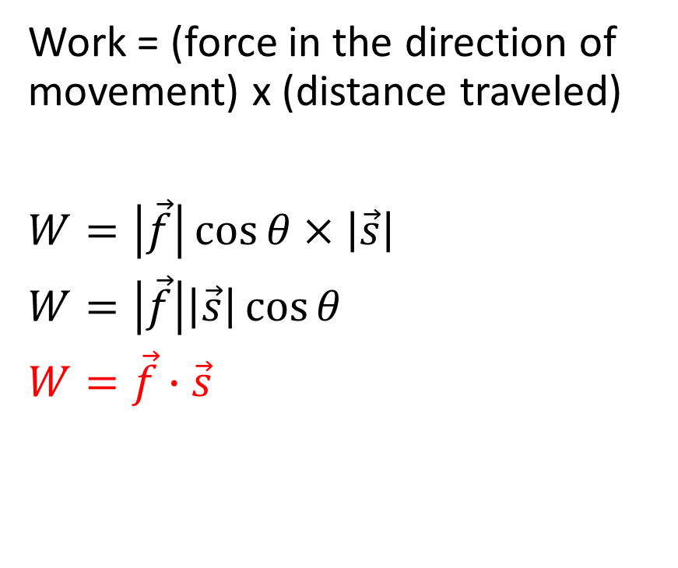
Work = (force in the direction of movement) x (distance traveled)
$W=\left|\vec{f}\right|\cos{θ}×\left|\vec{s}\right|$
$W=\left|\vec{f}\right|\left|\vec{s}\right|\cos{θ}$
$W=\vec{f}∙\vec{s}$
B
$$\vec{f}$$
O
N
A

Slide 7
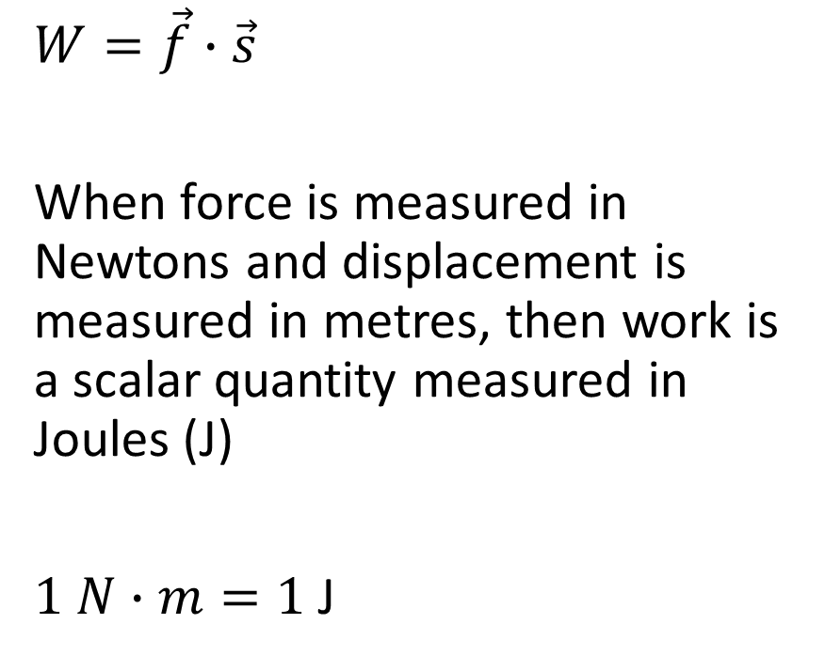
$W=\vec{f}∙\vec{s}$
When force is measured in Newtons and displacement is measured in metres, then work is a scalar quantity measured in Joules (J)
$1 N∙m=1$J
B
$$\vec{f}$$
O
N
A

Slide 8
Example involving Work
Marianna is pulling her daughter in a toboggan and is exerting a force of 40 N acting at 24° to the ground. If Marianna pulls the child a distance of 100 m, how much work was done?

Slide 9
Marianna is pulling her daughter in a toboggan and is exerting a force of 40 N acting at 24° to the ground. If Marianna pulls the child a distance of 100 m, how much work was done?
40 N
100 m

Slide 10
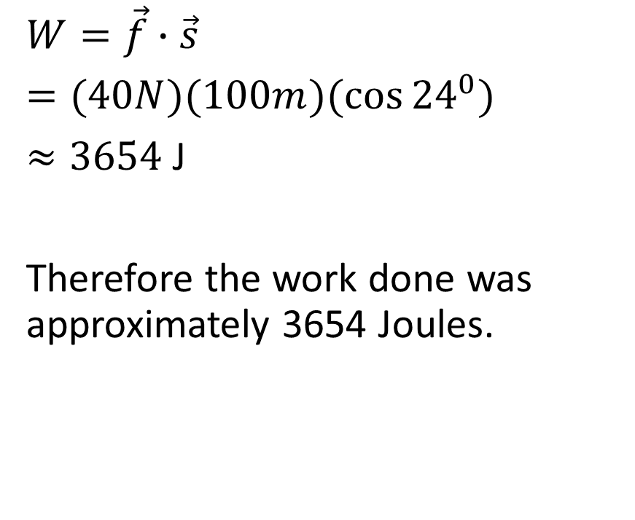
Marianna is pulling her daughter in a toboggan and is exerting a force of 40 N acting at 24° to the ground. If Marianna pulls the child a distance of 100 m, how much work was done?
$W=\vec{f}∙\vec{s}$
$=(40N)(100m)(\cos{{24}^{0})}$
$≈3654$ J
Therefore the work done was approximately 3654 Joules.
40 N
100 m

Slide 11



Application 2: Area
Part 1: Imagine the parallelogram formed by the vectors $\vec{a}$ and $\vec{b}$
$$\vec{b}$$
$$\vec{a}$$

Slide 12

Imagine the parallelogram formed by the vectors $\vec{a}$ and $\vec{b}$
$$\vec{b}$$
$$\vec{a}$$

Slide 13
Imagine the parallelogram formed by the vectors $\vec{a}$ and $\vec{b}$
$$\vec{b}$$
h
$$\vec{a}$$

Slide 14

Imagine the parallelogram formed by the vectors $\vec{a}$ and $\vec{b}$
Area of a parallelogram = base x height
$A=\left|\vec{a}\right|h$
$$\vec{b}$$
h
$$\vec{a}$$

Slide 15
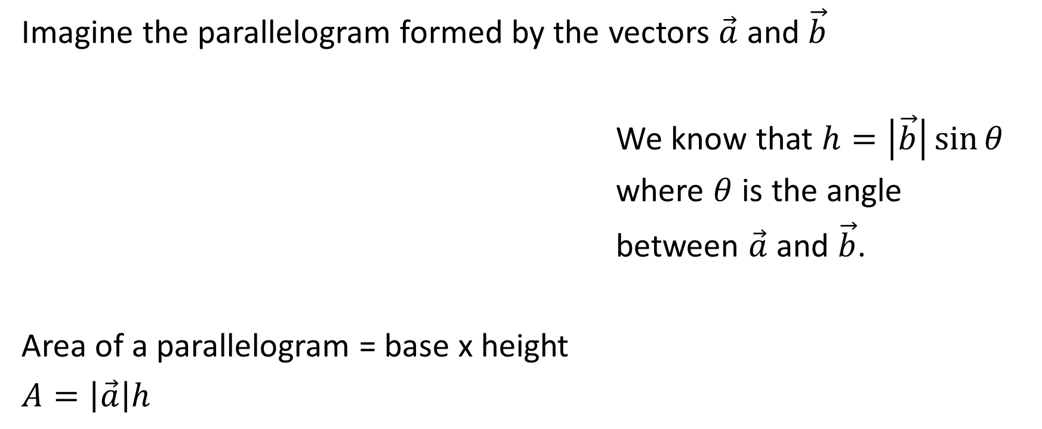

Imagine the parallelogram formed by the vectors $\vec{a}$ and $\vec{b}$
We know that $h=\left|\vec{b}\right|\sin{θ}$
where $θ$ is the angle
between $\vec{a}$ and $\vec{b}$.
Area of a parallelogram = base x height
$A=\left|\vec{a}\right|h$
$$\vec{b}$$
h
$$\vec{a}$$

Slide 16
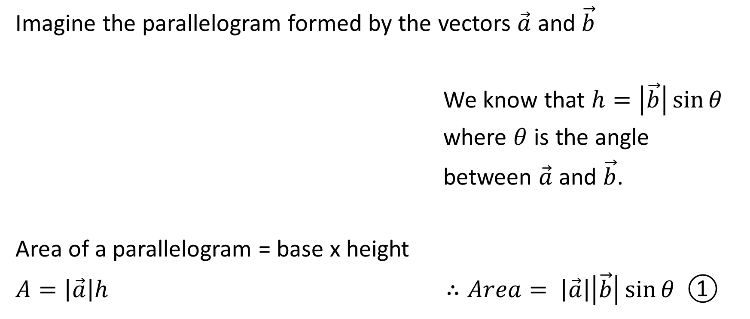
Imagine the parallelogram formed by the vectors $\vec{a}$ and $\vec{b}$
We know that $h=\left|\vec{b}\right|\sin{θ}$
where $θ$ is the angle
between $\vec{a}$ and $\vec{b}$.
Area of a parallelogram = base x height
$A=\left|\vec{a}\right|h$ $∴Area= \left|\vec{a}\right|\left|\vec{b}\right|\sin{θ}$ ①
$$\vec{b}$$
h
$$\vec{a}$$

Slide 17
Part 2: We’re now going to do some other, seemingly unrelated work, and we’ll bring it around to show that it is relevant to the work we just did.

Slide 18
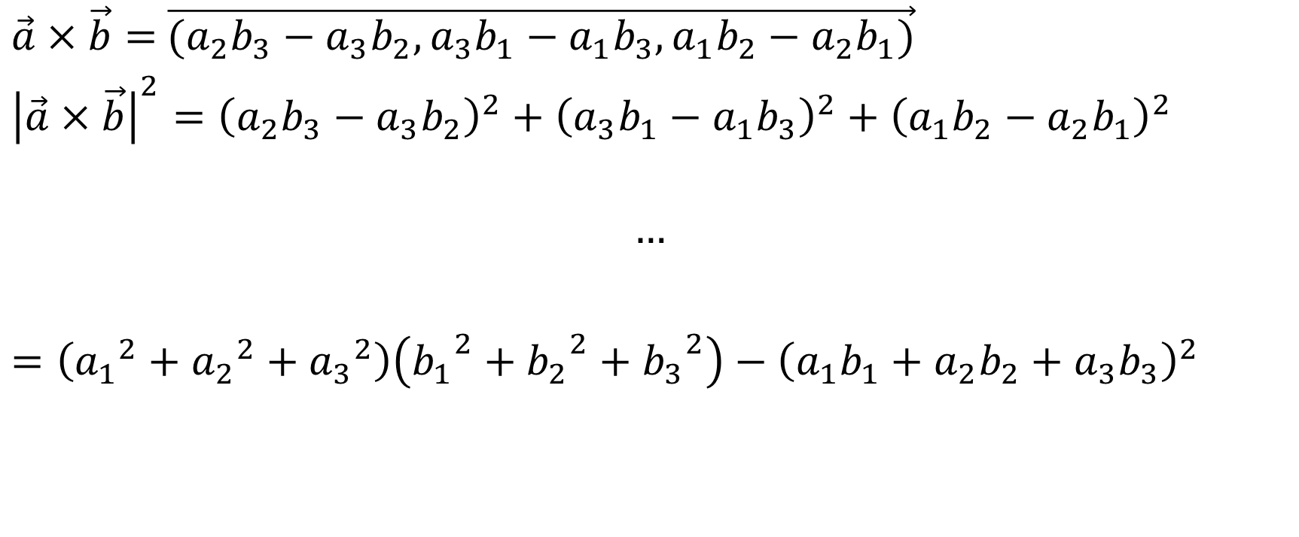
$\vec{a}×\vec{b}=$ $\vec{(a_{2}b_{3}−a_{3}b_{2},a_{3}b_{1}−a_{1}b_{3},a_{1}b_{2}−a_{2}b_{1})}$
${\left|\vec{a}×\vec{b}\right|}^{2}={\left(a_{2}b_{3}−a_{3}b_{2}\right)}^{2}+{\left(a_{3}b_{1}−a_{1}b_{3}\right)}^{2}+{\left(a_{1}b_{2}−a_{2}b_{1}\right)}^{2}$
$$…$$
$=\left({a_{1}}^{2}+{a_{2}}^{2}+{a_{3}}^{2}\right)\left({b_{1}}^{2}+{b_{2}}^{2}+{b_{3}}^{2}\right)−{\left(a_{1}b_{1}+a_{2}b_{2}+a_{3}b_{3}\right)}^{2}$

Slide 19










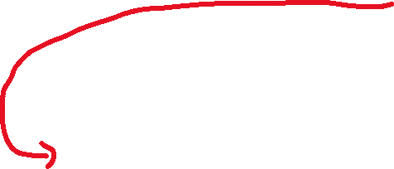



$\vec{a}×\vec{b}=$ $\vec{(a_{2}b_{3}−a_{3}b_{2},a_{3}b_{1}−a_{1}b_{3},a_{1}b_{2}−a_{2}b_{1})}$
${\left|\vec{a}×\vec{b}\right|}^{2}={\left(a_{2}b_{3}−a_{3}b_{2}\right)}^{2}+{\left(a_{3}b_{1}−a_{1}b_{3}\right)}^{2}+{\left(a_{1}b_{2}−a_{2}b_{1}\right)}^{2}$
$$…$$
$=\left({a_{1}}^{2}+{a_{2}}^{2}+{a_{3}}^{2}\right)\left({b_{1}}^{2}+{b_{2}}^{2}+{b_{3}}^{2}\right)−{\left(a_{1}b_{1}+a_{2}b_{2}+a_{3}b_{3}\right)}^{2}$

Slide 20






























Slide 21











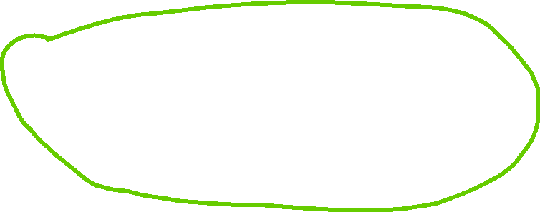




Slide 22






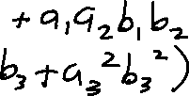





















Slide 23











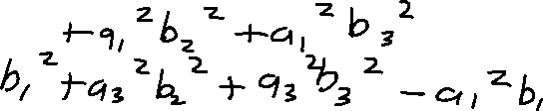













Slide 24

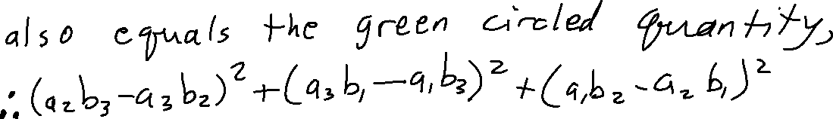


















Slide 25





Slide 26
$\vec{a}×\vec{b}=$ $\vec{(a_{2}b_{3}−a_{3}b_{2},a_{3}b_{1}−a_{1}b_{3},a_{1}b_{2}−a_{2}b_{1})}$
${\left|\vec{a}×\vec{b}\right|}^{2}={\left(a_{2}b_{3}−a_{3}b_{2}\right)}^{2}+{\left(a_{3}b_{1}−a_{1}b_{3}\right)}^{2}+{\left(a_{1}b_{2}−a_{2}b_{1}\right)}^{2}$
$$…$$
$=\left({a_{1}}^{2}+{a_{2}}^{2}+{a_{3}}^{2}\right)\left({b_{1}}^{2}+{b_{2}}^{2}+{b_{3}}^{2}\right)−{\left(a_{1}b_{1}+a_{2}b_{2}+a_{3}b_{3}\right)}^{2}$

Slide 27

$\vec{a}×\vec{b}=$ $\vec{(a_{2}b_{3}−a_{3}b_{2},a_{3}b_{1}−a_{1}b_{3},a_{1}b_{2}−a_{2}b_{1})}$
${\left|\vec{a}×\vec{b}\right|}^{2}={\left(a_{2}b_{3}−a_{3}b_{2}\right)}^{2}+{\left(a_{3}b_{1}−a_{1}b_{3}\right)}^{2}+{\left(a_{1}b_{2}−a_{2}b_{1}\right)}^{2}$
$=\left({a_{1}}^{2}+{a_{2}}^{2}+{a_{3}}^{2}\right)\left({b_{1}}^{1}+{b_{2}}^{2}+{b_{3}}^{2}\right)−{\left(a_{1}b_{1}+a_{2}b_{2}+a_{3}b_{3}\right)}^{2}$

Slide 28
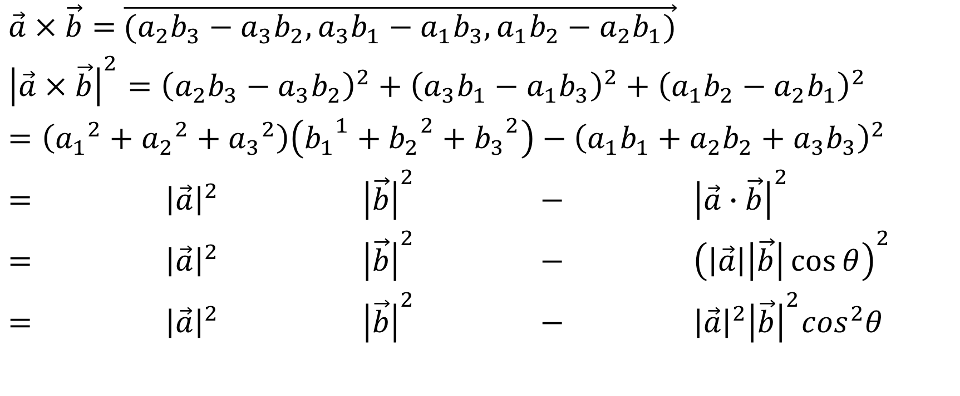
$\vec{a}×\vec{b}=$ $\vec{(a_{2}b_{3}−a_{3}b_{2},a_{3}b_{1}−a_{1}b_{3},a_{1}b_{2}−a_{2}b_{1})}$
${\left|\vec{a}×\vec{b}\right|}^{2}={\left(a_{2}b_{3}−a_{3}b_{2}\right)}^{2}+{\left(a_{3}b_{1}−a_{1}b_{3}\right)}^{2}+{\left(a_{1}b_{2}−a_{2}b_{1}\right)}^{2}$
$=\left({a_{1}}^{2}+{a_{2}}^{2}+{a_{3}}^{2}\right)\left({b_{1}}^{1}+{b_{2}}^{2}+{b_{3}}^{2}\right)−{\left(a_{1}b_{1}+a_{2}b_{2}+a_{3}b_{3}\right)}^{2}$
$={ \left|\vec{a}\right|}^{2}{ \left|\vec{b}\right|}^{2} − {\left|\vec{a}∙\vec{b}\right|}^{2}$
$={ \left|\vec{a}\right|}^{2}{ \left|\vec{b}\right|}^{2} − {\left(\left|\vec{a}\right|\left|\vec{b}\right|\cos{θ}\right)}^{2}$
$={ \left|\vec{a}\right|}^{2}{ \left|\vec{b}\right|}^{2} − {\left|\vec{a}\right|}^{2}{\left|\vec{b}\right|}^{2}\cos^{2}θ$

Slide 29

${\left|\vec{a}×\vec{b}\right|}^{2}={ \left|\vec{a}\right|}^{2}{ \left|\vec{b}\right|}^{2}− {\left|\vec{a}\right|}^{2}{\left|\vec{b}\right|}^{2}\cos^{2}θ$

Slide 30

${\left|\vec{a}×\vec{b}\right|}^{2}={ \left|\vec{a}\right|}^{2}{ \left|\vec{b}\right|}^{2}− {\left|\vec{a}\right|}^{2}{\left|\vec{b}\right|}^{2}\cos^{2}θ$
$={\left|\vec{a}\right|}^{2}{\left|\vec{b}\right|}^{2}\left(1−\cos^{2}θ\right)$
$={\left|\vec{a}\right|}^{2}{\left|\vec{b}\right|}^{2}\sin^{2}θ$

Slide 31

${\left|\vec{a}×\vec{b}\right|}^{2}={ \left|\vec{a}\right|}^{2}{ \left|\vec{b}\right|}^{2}− {\left|\vec{a}\right|}^{2}{\left|\vec{b}\right|}^{2}\cos^{2}θ$
$={\left|\vec{a}\right|}^{2}{\left|\vec{b}\right|}^{2}\left(1−\cos^{2}θ\right)$
$={\left|\vec{a}\right|}^{2}{\left|\vec{b}\right|}^{2}\sin^{2}θ$
$∴\left|\vec{a}×\vec{b}\right|=\left|\vec{a}\right|\left|\vec{b}\right|\sin{θ}$ ②

Slide 32
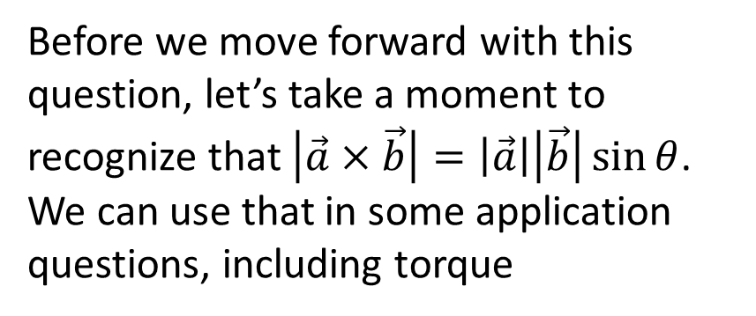

${\left|\vec{a}×\vec{b}\right|}^{2}={ \left|\vec{a}\right|}^{2}{ \left|\vec{b}\right|}^{2}− {\left|\vec{a}\right|}^{2}{\left|\vec{b}\right|}^{2}\cos^{2}θ$
$={\left|\vec{a}\right|}^{2}{\left|\vec{b}\right|}^{2}\left(1−\cos^{2}θ\right)$
$={\left|\vec{a}\right|}^{2}{\left|\vec{b}\right|}^{2}\sin^{2}θ$
$∴\left|\vec{a}×\vec{b}\right|=\left|\vec{a}\right|\left|\vec{b}\right|\sin{θ}$ ②
Before we move forward with this question, let’s take a moment to recognize that $\left|\vec{a}×\vec{b}\right|=\left|\vec{a}\right|\left|\vec{b}\right|\sin{θ}$. We can use that in some application questions, including torque

Slide 33
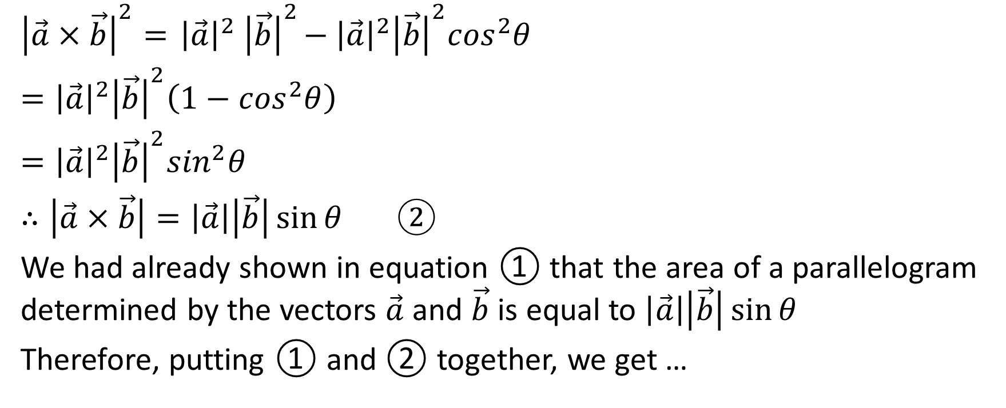
${\left|\vec{a}×\vec{b}\right|}^{2}={ \left|\vec{a}\right|}^{2}{ \left|\vec{b}\right|}^{2}− {\left|\vec{a}\right|}^{2}{\left|\vec{b}\right|}^{2}\cos^{2}θ$
$={\left|\vec{a}\right|}^{2}{\left|\vec{b}\right|}^{2}\left(1−\cos^{2}θ\right)$
$={\left|\vec{a}\right|}^{2}{\left|\vec{b}\right|}^{2}\sin^{2}θ$
$∴\left|\vec{a}×\vec{b}\right|=\left|\vec{a}\right|\left|\vec{b}\right|\sin{θ}$ ②
We had already shown in equation ① that the area of a parallelogram determined by the vectors $\vec{a}$ and $\vec{b}$ is equal to $\left|\vec{a}\right|\left|\vec{b}\right|\sin{θ}$
Therefore, putting ① and ② together, we get …

Slide 34

Area
The area of a parallelogram determined by the vectors $\vec{a}$ and $\vec{b}$ is equal to $\left|\vec{a}×\vec{b}\right|$

Slide 35
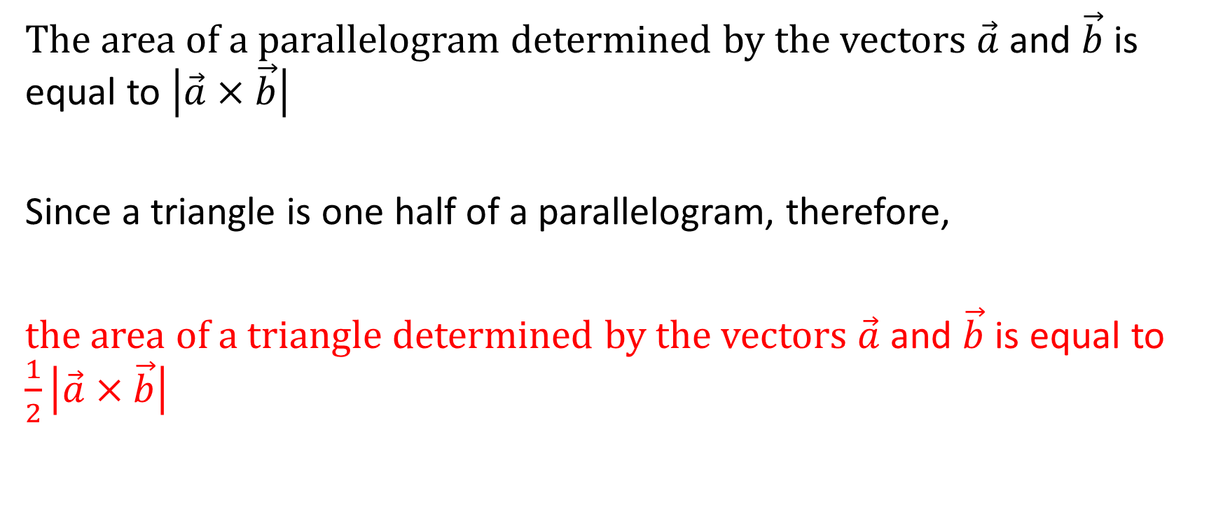
The area of a parallelogram determined by the vectors $\vec{a}$ and $\vec{b}$ is equal to $\left|\vec{a}×\vec{b}\right|$
Since a triangle is one half of a parallelogram, therefore,
the area of a triangle determined by the vectors $\vec{a}$ and $\vec{b}$ is equal to $\frac{1}{2}\left|\vec{a}×\vec{b}\right|$

Slide 36

Example 1 Re: Area
Determine the area of the parallelogram determined by the vectors
$\vec{a}=\vec{(4,−7,5)}$ and $\vec{b}=\vec{(−1,0,2)}$

Slide 37


Determine the area of the parallelogram determined by the vectors
$\vec{a}=\vec{(4,−7,5)}$ and $\vec{b}=\vec{(−1,0,2)}$
Solution:
-7 0
2
-1
-7 0

Slide 38




Determine the area of the parallelogram determined by the vectors
$\vec{a}=\vec{(4,−7,5)}$ and $\vec{b}=\vec{(−1,0,2)}$
Solution:
-7 0
2
-1
-7 0

Slide 39
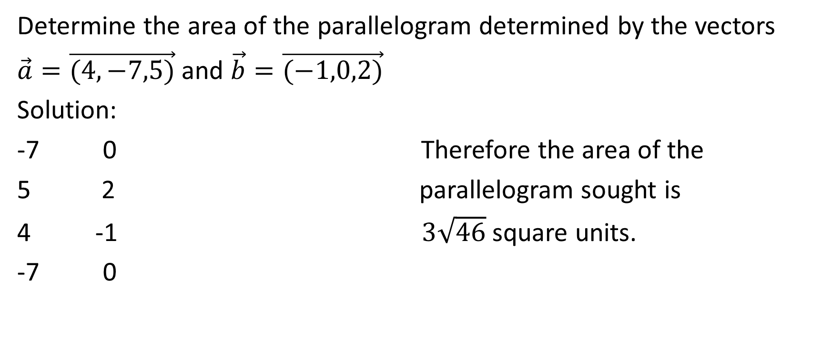
Determine the area of the parallelogram determined by the vectors
$\vec{a}=\vec{(4,−7,5)}$ and $\vec{b}=\vec{(−1,0,2)}$
Solution:
-7 0 Therefore the area of the
2 parallelogram sought is
-1 $3\sqrt{46}$ square units.
-7 0

Slide 40

Example 2 Re: Area
Determine the area of the triangle determined by the vectors $\vec{u}=\vec{(−6,−1,−4)}$ and $\vec{v}=\vec{(15,2,1)}$

Slide 41

Determine the area of the triangle determined by the vectors $\vec{u}=\vec{(−6,−1,−4)}$ and $\vec{v}=\vec{(15,2,1)}$
Solution:
-1 2
-4 1
-6 15
-1 2

Slide 42






Determine the area of the triangle determined by the vectors $\vec{u}=\vec{(−6,−1,−4)}$ and $\vec{v}=\vec{(15,2,1)}$
Solution:
-1 2
-4 1
-6 15
-1 2

Slide 43
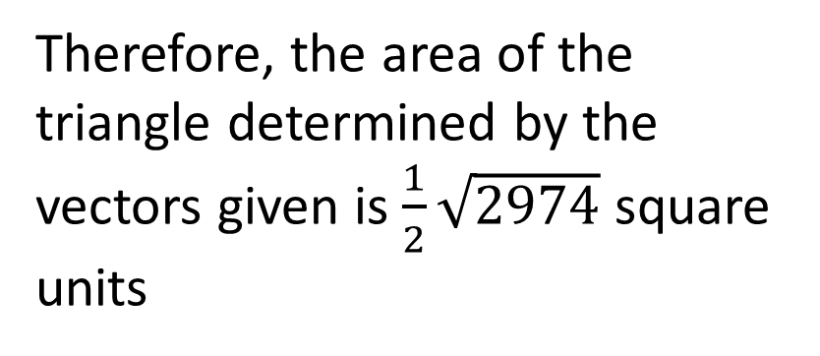
Determine the area of the triangle determined by the vectors $\vec{u}=\vec{(−6,−1,−4)}$ and $\vec{v}=\vec{(15,2,1)}$
Solution:
-1 2
-4 1
-6 15
-1 2
Therefore, the area of the triangle determined by the vectors given is $\frac{1}{2}\sqrt{2974}$ square units

Slide 44
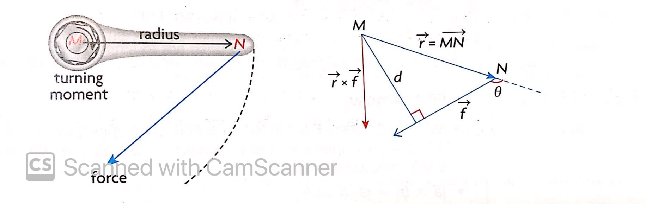
Torque
Torque is the turning effect (twisting effect) of a force about a point

Slide 45
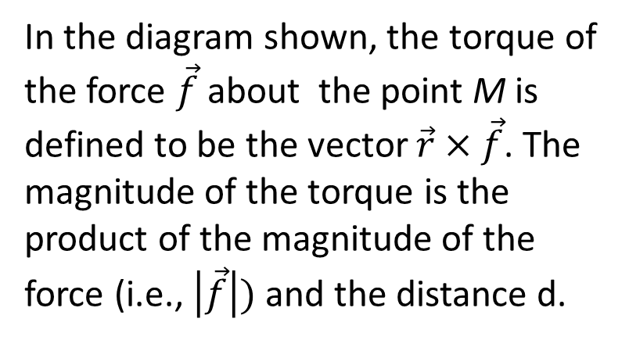
Torque is the turning effect (twisting effect) of a force about a point
In the diagram shown, the torque of the force $\vec{f}$ about the point M is defined to be the vector $\vec{r}×\vec{f}$. The magnitude of the torque is the product of the magnitude of the force (i.e., $\left|\vec{f}\right|)$ and the distance d.

Slide 46
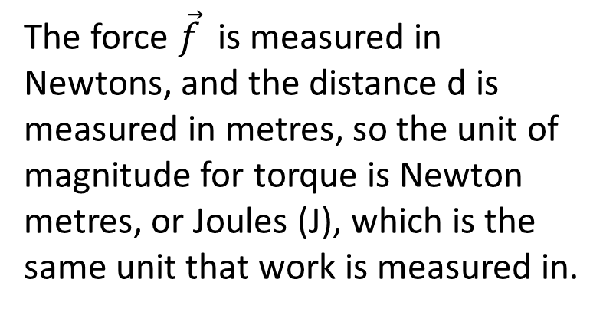
Torque is the turning effect (twisting effect) of a force about a point
The force $\vec{f}$ is measured in Newtons, and the distance d is measured in metres, so the unit of magnitude for torque is Newton metres, or Joules (J), which is the same unit that work is measured in.

Slide 47
Example re: Torque
A 20 N force is applied at the end of a wrench that is 40 cm in length. The force is applied at an angle of 60º to the wrench. Calculate the magnitude of the torque about the point of rotation M.

Slide 48
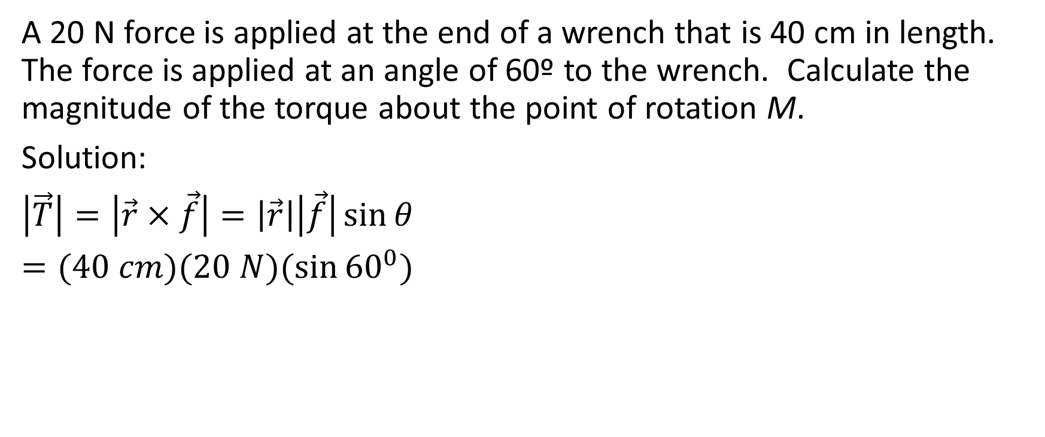
Example re: Torque
A 20 N force is applied at the end of a wrench that is 40 cm in length. The force is applied at an angle of 60º to the wrench. Calculate the magnitude of the torque about the point of rotation M.
Solution:
$\left|\vec{T}\right|=\left|\vec{r}×\vec{f}\right|=\left|\vec{r}\right|\left|\vec{f}\right|\sin{θ}$
$=(40 cm)(20 N)(\sin{{60}^{0})}$

Slide 49
Example re: Torque
A 20 N force is applied at the end of a wrench that is 40 cm in length. The force is applied at an angle of 60º to the wrench. Calculate the magnitude of the torque about the point of rotation M.
Solution:
$\left|\vec{T}\right|=\left|\vec{r}×\vec{f}\right|=\left|\vec{r}\right|\left|\vec{f}\right|\sin{θ}$
$=(40 cm)(20 N)(\sin{{60}^{0})}$
Convert cm to metres
40 cm = 0.4 m

Slide 50
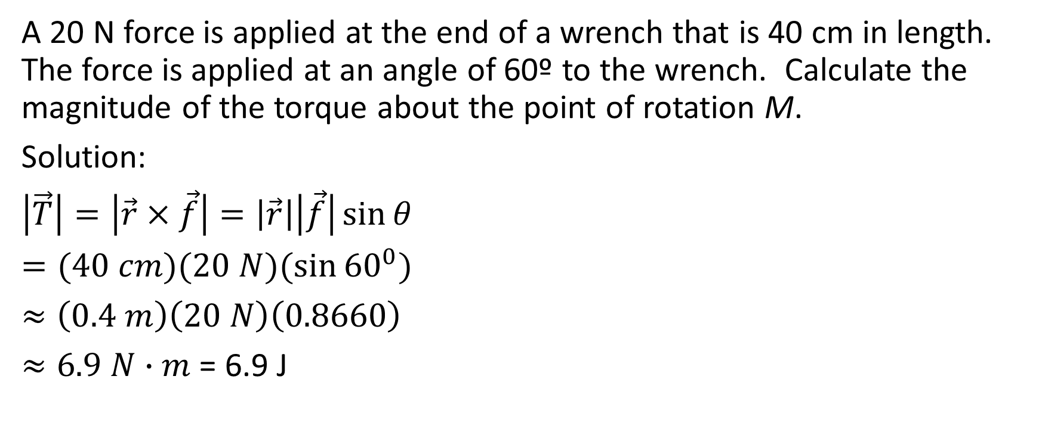
Example re: Torque
A 20 N force is applied at the end of a wrench that is 40 cm in length. The force is applied at an angle of 60º to the wrench. Calculate the magnitude of the torque about the point of rotation M.
Solution:
$\left|\vec{T}\right|=\left|\vec{r}×\vec{f}\right|=\left|\vec{r}\right|\left|\vec{f}\right|\sin{θ}$
$=(40 cm)(20 N)(\sin{{60}^{0})}$
$≈\left(0.4 m\right)\left(20 N\right)\left(0.8660\right)$
$≈6.9 N∙m$ = 6.9 J

Slide 51
Example re: Torque
A 20 N force is applied at the end of a wrench that is 40 cm in length. The force is applied at an angle of 60º to the wrench. Calculate the magnitude of the torque about the point of rotation M.
Solution:
$\left|\vec{T}\right|=\left|\vec{r}×\vec{f}\right|=\left|\vec{r}\right|\left|\vec{f}\right|\sin{θ}$
$=(40 cm)(20 N)(\sin{{60}^{0})}$
$≈\left(0.4 m\right)\left(20 N\right)\left(0.8660\right)$
$≈6.9 N∙m$ = 6.9 J
Therefore the magnitude of the torque is approximately 6.9 Joules

